Slide 1

http://www.r2d3.us/visual-intro-to-machine-learning-part-1/
P peline
The Data
Machine Learning I: Training and Testing
© Jennifer Mankoff
The Data Pipeline; HCII; Spring 2017
Slides modified & borrowed from Carolyn Rosé
Want to go deeper? http://see.stanford.edu/see/lecturelist.aspx?coll=348ca38a-3a6d-4052-937d-cb017338d7b1
Notes:
XX

Slide 2
Things to consider adding
Explain what regularization is and why it is useful.
What are the benefits and drawbacks of specific methods, such as ridge regression and LASSO?
Explain what a local optimum is and why it is important in a specific context, such as k-means clustering.
What are specific ways for determining if you have a local optimum problem? What can be done to avoid local optima?
Assume you need to generate a predictive model of a quantitative outcome variable using multiple regression. Explain how you intend to validate this model.
Explain what precision and recall are. How do they relate to the ROC curve?
Explain what a long tailed distribution is and provide three examples of relevant phenomena that have long tails. Why are they important in classification and prediction problems?
What is latent semantic indexing? What is it used for? What are the specific limitations of the method?

Slide 3
More to add
What is the Central Limit Theorem? Explain it. Why is it important? When does it fail to hold?
What is statistical power? Explain what resampling methods are and why they are useful. Also explain their limitations.
Explain the differences between artificial neural networks with softmax activation, logistic regression, and the maximum entropy classifier.
Explain selection bias (with regards to a dataset, not variable selection). Why is it important? How can data management procedures such as missing data handling make it worse?
Provide a simple example of how an experimental design can help answer a question about behavior.

Slide 4
Naïve Approach: When all you have is a hammer…
Many people learn one algorithm (e.g., regression) and always use it
Notes:
XX move this url / viz to the next deck… also need a better intro…

Slide 5
Naïve Approach: When all you have is a hammer…
Many people learn one algorithm (e.g., regression) and always use it
Won’t lead to the best results!

Slide 6
Naïve Approach: When all you have is a hammer…
Many people learn one algorithm (e.g., regression) and always use it
Different approaches fit different data better or worse

Slide 7
Naïve Approach: When all you have is a hammer…
Many people learn one algorithm (e.g., regression) and always use it
Others aimlessly wander

Slide 8
Naïve Approach: When all you have is a hammer…
Many people learn one algorithm (e.g., regression) and always use it
Others aimlessly wander
Machine learning takes to long for this to work well!
Also may not be comprehensive

Slide 9
Naïve Approach: When all you have is a hammer…
Many people learn one algorithm (e.g., regression) and always use it
Others aimlessly wander
Solution: PROCESS KNOWLEDGE

Slide 10
Naïve Approach: When all you have is a hammer…
Many people learn one algorithm (e.g., regression) and always use it
Others aimlessly wander
Solution: PROCESS KNOWLEDGE
Know the capabilities and limitations of algorithms
Generate hypotheses from the data
Conduct careful error analysis when things go wrong

Slide 11
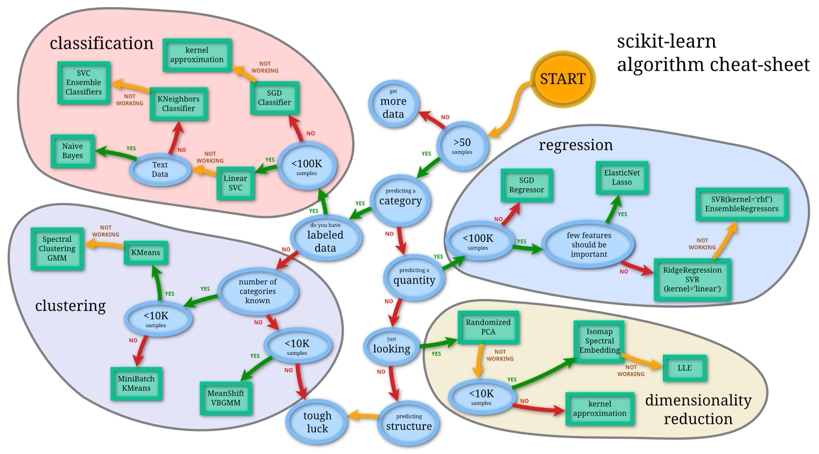
Selecting algorithms
http://www.quora.com/What-are-the-advantages-of-different-classification-algorithms

Slide 12
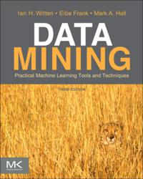
Suggested Readings
Witten, I. H., Frank, E., Hall, M. (2011). Data Mining: Practical Machine Learning Tools and Techniques, third edition, Elsevier: San Francisco
Suggested watching (or see his coursera course) http://see.stanford.edu/see/lecturelist.aspx?coll=348ca38a-3a6d-4052-937d-cb017338d7b1

Slide 13
“Just enough to be dangerous”…
ML department devoted to this subject!
Practical start
(Very) basic concepts
A start on what questions to ask
But don’t leave thinking you now know all about ML!

Slide 14
What is machine learning?
Automatically or semi-automatically
Inducing concepts (i.e., rules) from data
Finding patterns in data
Explaining data
Making predictions

Slide 15
Two main approaches
Supervised learning (we have lots of examples of what should be predicted)
Unsupervised learning (e.g. clustering into groups and inferring what they are about)
Can combine these (semi-supervised)
Can learn over time or train up front

Slide 16
Example uses of ML
Recognizing what appliance is being used from whole-house energy (“NILM”)
Recognizing activities
Predicting sewer overflows
Figuring out which set of documents an email is similar to (could know about sets as ‘spam’ ‘not spam’ or just care about better search results)
Recommending movies

Slide 17
Today’s Focus
Supervised learning (we have lots of examples of what should be predicted)
Unsupervised learning (e.g. clustering into groups and inferring what they are about)
Can combine these (semi-supervised)
Can learn over time or train up front

Slide 18
Typical Supervised Learning Flow
Two steps
Training
Data
Learning Algorithm
Model

Slide 19
Typical Supervised Learning Flow
Two steps
Training
Prediction
Data
Learning Algorithm
Model
Classification Engine
Prediction
New Data

Slide 20
Example: Sewer Overflows
GIVEN “features” such as
Steeler’s Game Ad?
Weather
…

Slide 21
Example: Sewer Overflows
GIVEN “features” such as
Steeler’s Game Ad?
Weather
…
PREDICT overflow (yes or no)

Slide 22
Example: Sewer Overflows
GIVEN “features” such as
Steeler’s Game Ad?
Weather
…
PREDICT overflow (yes or no)
Class “A”

Slide 23
Example: Sewer Overflows
GIVEN “features” such as
Steeler’s Game Ad?
Weather
…
PREDICT overflow (yes or no)
Class “B”

Slide 24
Example: Sewer Overflows
GIVEN “features” such as
Steeler’s Game Ad?
Weather
…
PREDICT overflow (yes or no)
Typical approach: “Classification”

Slide 25
Classification
Take a set of observed features F = <f1, f2, f3,…> (a feature vector)
Use this to estimate which class it belongs to
(a prediction)

Slide 26
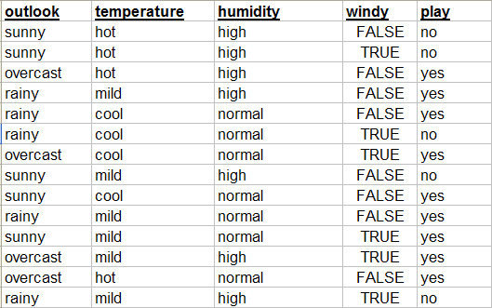
Training data: Multiple Examples

Slide 27
Including Features
Features

Slide 28
And Labels
Class

Slide 29
How does classification work?
Two simple algorithms
0R – Predict the majority class
1R – Use the most predictive single feature

Slide 30
How does classification work?
A slightly more sophisticated rule learner
will find the feature that gives the most
information about the result class. What
do you think that would be in this case?
The simplest rule learner will
learn to predict whatever is
the most frequent result class.
This is called the majority
Class.
Outlook:
Sunny -> No
Overcast -> Yes
Rainy-> Yes
<Feature Name>:
<value> -> <prediction>
<value> -> <prediction>
…
What will the rule be in this case?
It will always predict yes.

Slide 31
What will the prediction be?
Model
Outlook:
Sunny -> No
Overcast -> Yes
Rainy-> Yes
New Data
Yes

Slide 32
0R & 1R Classification
Problem: Brittle and error prone
Instead, ML classifiers use statistical models to learn from past data
Notes:
Very powerful…

Slide 33
Learned Classifiers
Training Time
Method to get Ground Truth
Training Data Set
Feature Gen
f₁ | f₂ | f₃ | … | Label
A | 42 | 17 | … | Yes
C | 78 | 25 |  | No
X | 32 | 4 |  | Yes
Learner
Sensors
Classifier

Slide 34
Learned Classifiers
Run/Classify Time
Feature Gen
Sensors
Classifier
Class

Slide 35
Learned Classifiers
Training Time
Training Data Set
Feature Gen
f₁ | f₂ | f₃ | … | Label
A | 42 | 17 | … | Yes
C | 78 | 25 |  | No
X | 32 | 4 |  | Yes
Learner
Sensors
Many learning algorithms to choose from
A few of the simplest ones tend to perform well
Naïve Bayes
Decision Trees
Regression-based Models (for continuous)
Classifier

Slide 36
Learned Classifiers
Training Time
Training Data Set
Feature Gen
f₁ | f₂ | f₃ | … | Label
A | 42 | 17 | … | Yes
C | 78 | 25 |  | No
X | 32 | 4 |  | Yes
Learner
Sensors
Many possible features
Different sensors
Multitude of ways to generate features
Many ways to transform and combine features
Some much more predictive / useful than others
→ “Feature selection” tends to be very important
Classifier

Slide 37
Learned Classifiers
Training Time
Training Data Set
Feature Gen
f₁ | f₂ | f₃ | … | Label
A | 42 | 17 | … | Yes
C | 78 | 25 |  | No
X | 32 | 4 |  | Yes
Learner
Sensors
Labeled data tends to be hard to come by
Tend to be expensive to gather or just non-existent
Typically need a lot of data to do well
Prefer 1000s of training samples
Classifier

Slide 38
How can I tell if my classifier is any good?
Common measure: Accuracy
X% of the time, the recognizer was right

Slide 39
How can I tell if my classifier is any good?
Common measure: Accuracy
X% of the time, the recognizer was right
But our data actually looks something like:
 | True Class : Sleeping | True Class: Biking
Predicted Class: Sleeping | 90 | 15
Predicted Class: Biking | 12 | 10

Slide 40
How can I tell if my classifier is any good?
Accuracy: (90+10)/(90+15+12+10) = 79%
What about all the other information here?
 | True Class : Sleeping | True Class: Biking
Predicted Class: Sleeping | 90 (True Positive) | 15
Predicted Class: Biking | 12 | 10 (True Negative)

Slide 41
Alternative takes on Accuracy
Precision = TP / (TP + FP) = 90/(90+15) = 86%
Recall = TP / (TP + FN) = 90/(90+12) = 88%
F-Score = 2 * (Precision * Recall) = 87%
(Precision + Recall)
 | True Class : Sleeping | True Class: Biking
Predicted Class: Sleeping | 90 (true positives) | 15 (false positive)
Predicted Class: Biking | 12 (false negative) | 10 (true negatives)

Slide 42
Kappa: Accounting for Skew
Kappa = (observed acc.- expected acc.) (1 - expected acc.)
 | True Class : Sleeping | True Class: Biking
Predicted Class: Sleeping | 90 (true positives) | 15 (false positive)
Predicted Class: Biking | 12 (false negative) | 10 (true negatives)

Slide 43
Kappa: Accounting for Skew
Kappa = (observed acc.- expected acc.) (1 - expected acc.)
Observed acc. = .79
 | True Class : Sleeping | True Class: Biking
Predicted Class: Sleeping | 90 (true positives) | 15 (false positive)
Predicted Class: Biking | 12 (false negative) | 10 (true negatives)

Slide 44
Kappa: Accounting for Skew
Kappa = (observed acc.- expected acc.) (1 - expected acc.)
Expected acc. E[activity]
need to compare ground truth to predictions
 | True Class : Sleeping | True Class: Biking
Predicted Class: Sleeping | 90 (true positives) | 15 (false positive)
Predicted Class: Biking | 12 (false negative) | 10 (true negatives)

Slide 45
Kappa: Accounting for Skew
Kappa = (observed acc.- expected acc.) (1 - expected acc.)
Expected acc. E[sleep] = F_{obs}(s)*F_{pred}(s)
N

Slide 46
Kappa: Accounting for Skew
Kappa = (observed acc.- expected acc.) (1 - expected acc.)
Expected acc. E[sleep] = F_{obs}(s)*F_{pred}(s)
N
Sum of all observed instances in the s (sleep) class = 90 + 12 = 102

Slide 47
Kappa: Accounting for Skew
Kappa = (observed acc.- expected acc.) (1 - expected acc.)
Expected acc. E[sleep] = F_{obs}(s)*F_{pred}(s)
N
Sum of all observed instances in the s (sleep) class = 90 + 12 = 102
Sum of all predicted instances in the s (sleep) class = 90 + 15 = 105

Slide 48
Kappa: Accounting for Skew
Kappa = (observed acc.- expected acc.) (1 - expected acc.)
Expected acc. E[sleep] = 102 * 105 = 84.33
127

Slide 49
Kappa: Accounting for Skew
Kappa = (observed acc.- expected acc.) (1 - expected acc.)
Expected acc. E[bike] = F_{obs}(b)*F_{pred}(b)
N

Slide 50
Kappa: Accounting for Skew
Kappa = (observed acc.- expected acc.) (1 - expected acc.)
Expected acc. E[bike] = 25 * 22 = 4.33
127

Slide 51
Kappa: Accounting for Skew
Kappa = (observed acc.- expected acc.) (1 - expected acc.)
Expected acc. E[activity] = E[sleeping] + E[Biking]
N
= (84.33 + 4.33) / 127
= .70

Slide 52
Kappa: Accounting for Skew
Kappa = (observed acc.- expected acc.) (1 - expected acc.)
Observed acc. = .79
Expected acc. E[activity] = .70
 | True Class : Sleeping | True Class: Biking
Predicted Class: Sleeping | 90 (true positives) | 15 (false positive)
Predicted Class: Biking | 12 (false negative) | 10 (true negatives)

Slide 53
Kappa: Accounting for Skew
Kappa = (.79 - .70) = .3 (terrible!) (1 - .70)
Observed acc. = .79
Expected acc. E[activity] = .70
 | True Class : Sleeping | True Class: Biking
Predicted Class: Sleeping | 90 (true positives) | 15 (false positive)
Predicted Class: Biking | 12 (false negative) | 10 (true negatives)

Slide 54
ROC Curve
Fogarty, James, Ryan S. Baker, and Scott E. Hudson. "Case studies in the use of ROC curve analysis for sensor-based estimates in human computer interaction." GI 2005.
Impact of probabilities for choosing classes
Notes:
The tradeoff at different thresholds (model estimated probability for a class) between obtaining more true positives at the expense of additional false positives is visualized in an ROC curve. Thresholds are distributed along the curve. The vertical location of the point for each threshold corresponding to the percentage of positive cases in the test data that are correctly labeled as positive when using the model at that threshold. The horizontal location of the point for each threshold is the percentage of negative cases in the test data that are incorrectly labeled as positive when using the model at that threshold.
Bottom left: everything negative; top right: everything positive.

Slide 55
Comparing classifiers
Typically use NHST over something like accuracy
Compare to 1R, and classifiers of your choice
0R can be used instead of Kappa as a comparison

Slide 56
Sources of Bias
Training and testing on same data (you know too much!)
Optimizing and training on same data (same effect)
Notes:
Called ‘holdout validation’ : need a large enough holdout set so you can trust the result (and this reduces your training data which you almost never have enough of)

Slide 57
Best Approach
Optimization set (for tuning parameters; etc.)
Training set (for training your classifier)
Testing set (for calculating scores)
Read your data. Explore it. Try things out (feature sets, algthm parameters). But do it all on the optimization set.
Notes:
Called ‘holdout validation’ : need a large enough holdout set so you can trust the result (and this reduces your training data which you almost never have enough of)

Slide 58
Best Approach
Optimization set (for tuning parameters; etc.)
Training set (for training your classifier)
Testing set (for calculating scores)
Use this for training. Produces a classifier.
Notes:
Called ‘holdout validation’ : need a large enough holdout set so you can trust the result (and this reduces your training data which you almost never have enough of)

Slide 59
Best Approach
Optimization set (for tuning parameters; etc.)
Training set (for training your classifier)
Testing set (for calculating scores)
Eventually you will run the classifier on ‘real world’ (unlabeled) data. But to know how well it works, you need to run it on data.
Notes:
Called ‘holdout validation’ : need a large enough holdout set so you can trust the result (and this reduces your training data which you almost never have enough of)

Slide 60


Slide 61
Train
Test

Slide 62
If Outlook = sunny, no
else if Outlook = overcast, yes
else if Outlook = rainy and Windy = TRUE, no
else yes
Performance on
training data?

Slide 63
If Outlook = sunny, no
else if Outlook = overcast, yes
else if Outlook = rainy and Windy = TRUE, no
else yes
Performance on
training data?
Performance on
testing data?

Slide 64
If Outlook = sunny, no
else if Outlook = overcast, yes
else if Outlook = rainy and Windy = TRUE, no
else yes
IMPORTANT!
If you evaluate the performance
of your rule on the same data
you trained on, you won’t
get an accurate estimate of
how well it will do on new data.

Slide 65
Best Approach
Optimization set (for tuning parameters; etc.)
Training set (for training your classifier)
Testing set (for calculating scores)
In practice: Not enough labeled data!
Never give up on the optimization set, just make it smaller
Notes:
Called ‘holdout validation’ : need a large enough holdout set so you can trust the result (and this reduces your training data which you almost never have enough of)

Slide 66
Cross Validation Helps for Small Data Sets
Fold: 1
Let’s say your data has attributes A, B, and C
You want to train a rule to predict D
First train on 2, 3, 4, 5, 6, 7, 8, 9, 10
and apply trained model to 1
The results is Accuracy1

Slide 67
Cross Validation Helps for Small Data Sets
Fold: 1
Let’s say your data has attributes A, B, and C
You want to train a rule to predict D
First train on 1, 3, 4, 5, 6, 7, 8, 9, 10
and apply trained model to 2
The results is Accuracy2

Slide 68
Cross Validation Helps for Small Data Sets
Fold: 1
Let’s say your data has attributes A, B, and C
You want to train a rule to predict D
First train on 1, 2, 4, 5, 6, 7, 8, 9, 10
and apply trained model to 3
The results is Accuracy3

Slide 69
Cross Validation Helps for Small Data Sets
Fold: 1
Let’s say your data has attributes A, B, and C
You want to train a rule to predict D
First train on 1, 2, 3, 5, 6, 7, 8, 9, 10
and apply trained model to 4
The results is Accuracy4

Slide 70
Cross Validation Helps for Small Data Sets
Fold: 1
Continue for all folds
Average the resulting accuracies

Slide 71
Cross Validation
Typically done with 10 subsamples (ten-fold cross validation)
Provides an estimate of performance on an independent sample
Makes the most of your data – large portion used for training
But many iterations you are using insights from your testing data in building your model -> need that optimization set
Partitioning
“Stratified” → randomly choose partitions but in a way guaranteeing that each class is represented in approximately the right proportion

Slide 72
Partitioning your data
“Stratified” → randomly choose partitions but in a way guaranteeing that each class is represented in approximately the right proportion
Notes:
But there are problems with this…a
If the training data is not very independent
Multiple very similar (identical?) training instances
(such as from the same person)
You will be back to testing against (a copy of part of) your training data
→ Estimates tend to end up too optimistic

Slide 73
Partitioning your data
“Stratified” → randomly choose partitions but in a way guaranteeing that each class is represented in approximately the right proportion
“Per Person” -> randomly choose one or more people to hold out (less standard, but may be more accurate)
Especially good if you want to know how your classifier would perform if a new user comes along

Slide 74
Do we have to do all of the folds?
Yes!
The test set on each fold is too small to give you an accurate estimate of performance alone
Variation across folds
Evaluation over part of the data is likely to be misleading

Slide 75
To make your classifier
If satisfied with the performance estimate we get using cross-validation
Build the model with the WHOLE SET
Don’t use cross-validation to build the model

Slide 76

To make your classifier…
If we are satisfied with the performance estimate we get
Then we build the model with the WHOLE SET
Now let’s see how it works…
If you are not satisfied with the
performance you get,
then you should try to determine
what went wrong,
and then evaluate a different model
that compensates.
Notes:
Using what part of your data? Ideally the optimization set

Slide 77
Feature Selection
Earlier indicated that feature selection is typically important to success
Very typical feature selection method: use information gain to “score” your features
Use the top N features ranked by information gain

Slide 78
Wrapper based feature selection
Combinatoric search / optimization through possible feature subsets using classifier accuracy as the objective function (this can be “wrapped” around any type of classifier)

Slide 79
Wrapper based feature selection
Combinatoric search / optimization through possible feature subsets using classifier accuracy as the objective function (this can be “wrapped” around any type of classifier)
Example:
Start with an empty set of selected features
Train a new classifier adding each candidate new feature
Keep the feature which produces the classifier with the best accuracy
Repeat until things stop improving

Slide 80
Wrapper Based Feature Selection Cons
This is an expensive process
Building and testing a classifier is “inside the loop” here so typically want a fast learner (e.g., naïve Bayes, decision trees)
What would happen if you do feature selection over your whole set of data prior to cross validation?

Slide 81
Wrapper Based Feature Selection Cons
This is an expensive process
Building and testing a classifier is “inside the loop” here so typically want a fast learner (e.g., naïve Bayes, decision trees)
Will overfit if you do it on entire data set (have to do on each fold)

Slide 82
Finding Features
The same problem occurs if you design new features based on observations over your whole set of data.
Can you explain why?
Notes:
Unfair advantage – you know more about the data than your system!
Your estimate will be overly optimistic

Slide 83
Finding Features
The same problem occurs if you design new features based on observations over your whole set of data.
At training time the features will perform better than they should because they were design based on the training data
At testing time, you will have used ‘omniscience’ to build features
Notes:
Unfair advantage – you know more about the data than your system!
Your estimate will be overly optimistic

Slide 84
Finding Features
The same problem occurs if you design new features based on observations over your whole set of data.
-> Yet another reason for the optimization set!

Slide 85
Software Tools
Weka (http://www.cs.waikato.ac.nz/ml/weka/)
Open source machine learning toolkit
Includes Java API
Data manipulation tools
Whatever you are comfortable with
Scripting language like Perl
Excel

Slide 86
Summary
Automatically or semi-automatically
Inducing concepts (i.e., rules) from data
Finding patterns in data
Explaining data
Making predictions
Supervised ML depends on labels and features
Labels typically expensive to acquire
Features key to success

Slide 87
Metrics for assessing results
Accuracy [limited value]
Precision = TP / (TP + FP) = 90/(90+15) = 88%
Recall = TP / (TP + FN) = 90/(90+12) = 86%
F-Score = 2 * (Precision * Recall) = 87%
(Precision + Recall)
Kappa = (observed acc.- expected acc.) (1 - expected acc.)
Notes:
Kappa accounts for skew

Slide 88
Best Practices
Divide your data
Optimization set (for tuning parameters; etc.)
Training set (for training your classifier)
Testing set (for calculating scores)
Estimate performance on training set (10 fold cross)
Test set is for reporting
All data is for producing a classifier to use in the real world
Read your data. Explore it. Try things out (feature sets, algthm parameters). But do it all on the optimization set.
Notes:
Called ‘holdout validation’ : need a large enough holdout set so you can trust the result (and this reduces your training data which you almost never have enough of)

Slide 89
If you want to know more…
Witten, I. H., Frank, E., Hall, M. (2011). Data Mining: Practical Machine Learning Tools and Techniques, third edition, Elsevier: San Francisco

